Slide 1
Data Warehousing Course Project
CieloVolo
Alex Chacon, Andrew Gersack, Michael Kennedy, & Giuliana Ziliotto

Slide 2
CieloVolo
Who Are We?
At CieloVolo, our eyes are on the sky. We pride ourselves on providing efficient and comfortable air travel for all passengers.
Who Do We Serve?
Offer domestic flights 20+ destinations in the most traveled states
Casual & business travelers to get from point A to point B without compromising on experience
Company Goals
Understand make-up of revenues & needs of consumer base (increase revenues)
Expand our operations to offer consumers additional destinations
Maintain competitive pricing strategy
Provide accessibility and impactful decision making within the travel industry

Slide 3
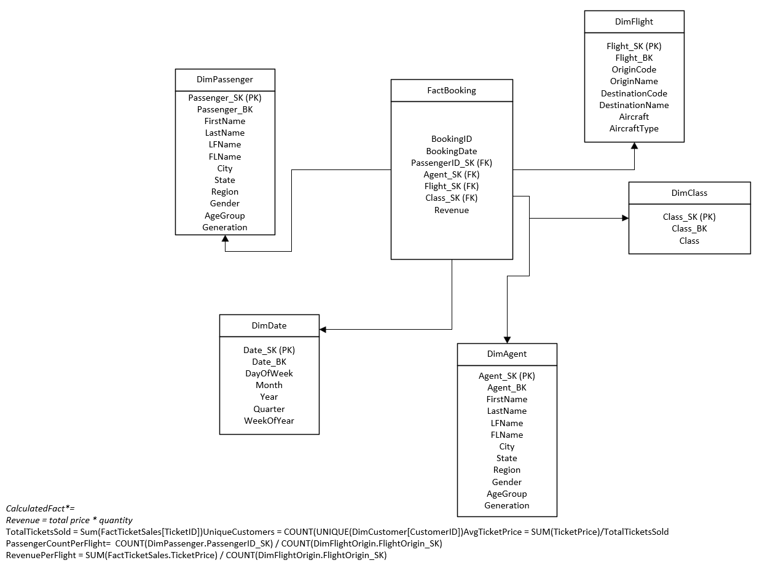
ERD & Data Organization

Slide 4
Business Requirement Questions
Total revenue from ticket sales by flight route (CEO)
Total revenue by class (CMO)
Passenger booking patterns by season (Marketing Director)
Top passengers booking multiple tickets over time (CFO)
Most popular destination (CMO)
Least popular destination (CMO)

Slide 5
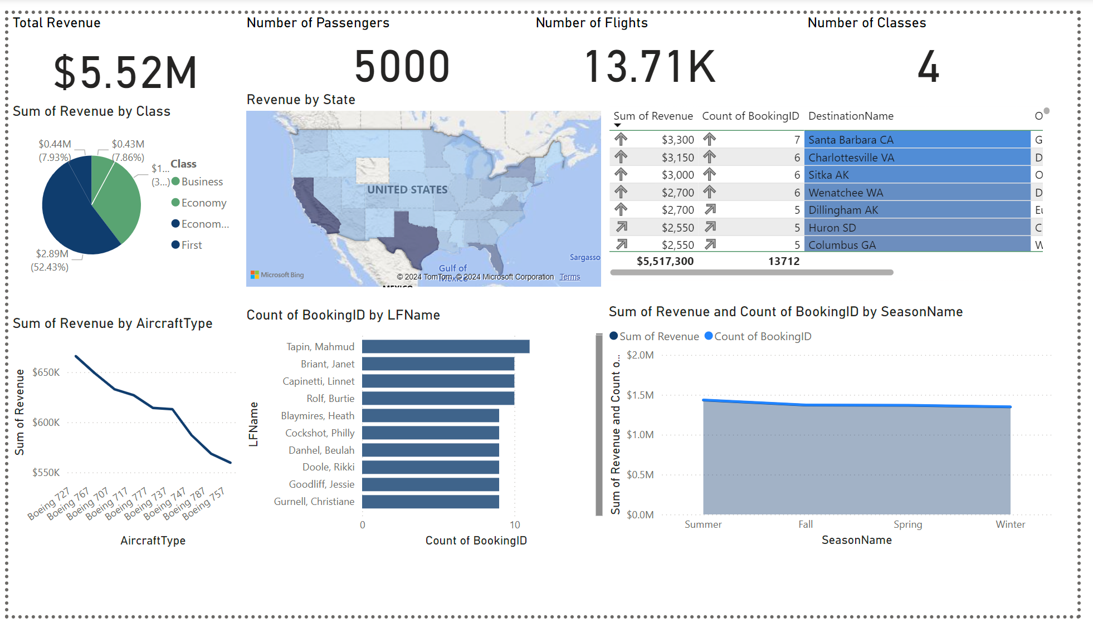
Dashboard Overview

Slide 6
Analysis & Findings
Total Revenue:
$5.52M
Business:
~8%
Economy:
~32%
Economy Plus:
~52%
Repeat Customer:
11 bookings
Seasonal High: Summer
Seasonal Low: Winter
Top destination: Santa Barbara, CA
Least popular: Columbus, GA
Popular States: CA, TX, FL

Slide 7
Recommendations
Increase promotions in underperforming seasons
Expand routes to most popular destinations & states
Work on fostering relationships with large business corporations to increase business class sales & revenues

Slide 8
Reflection
Major Challenge:
Aligning data sources to fit the star schema design efficiently.
Solution:
Iterative validation and testing in ETL processes ensured accuracy.
Key Takeaway:
Data integration is essential for actionable insights and business growth.

Slide 9
Thank YOU!
Happy Winter Break

